Slide 1
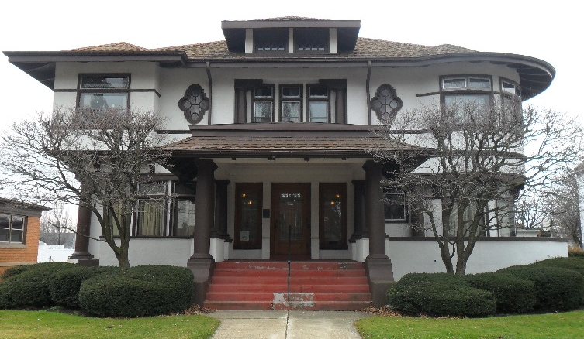
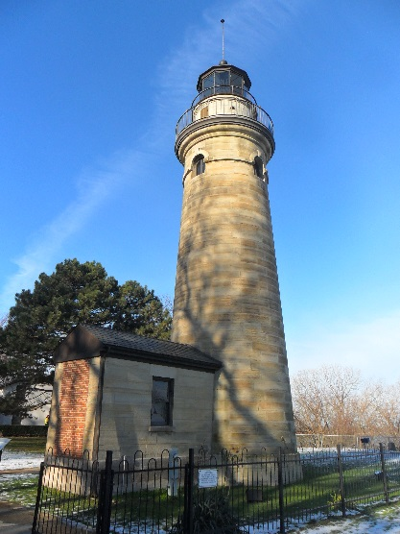
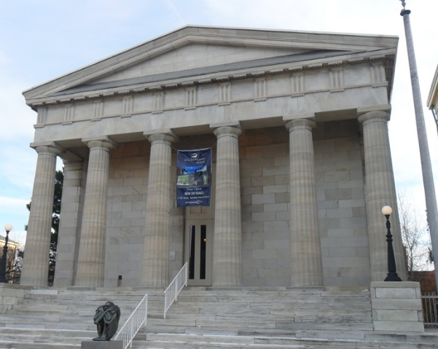
2014 Erie Historic Resource Survey
Notes:
Fairview Road facing southwest

Slide 2
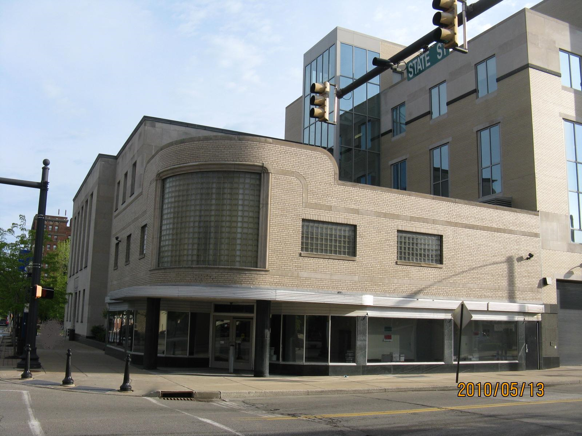
2014 Erie Historic Resource Survey
A County-wide survey of:
All 38 municipalities
over 31,000 buildings
25 Historic Districts

Slide 3
2014 Survey Sponsors
Preservation Erie
Erie County Gaming Revenue Authority
Perry 200 Bicentennial Committee
Erie Community Foundation

Slide 4
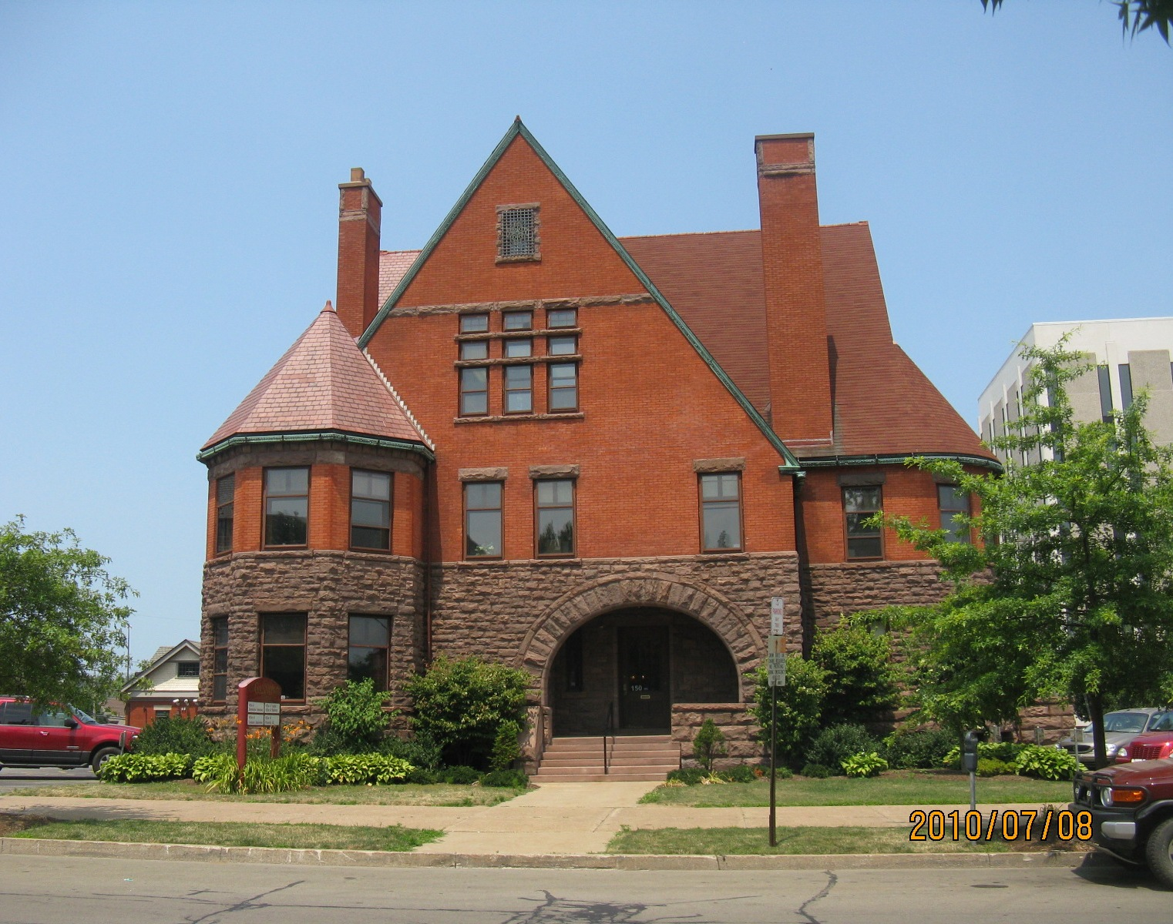
Project Management & Partners
Preservation Erie
Staff/Board Members
Mercyhurst University
County Historical Societies
Volunteers
Wise Preservation Planning LLC

Slide 5
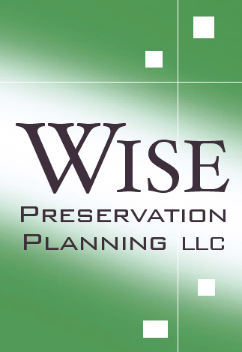
Wise Preservation Planning LLC
National Register Nominations
Historic Resource Impact Studies
Historic Resource Structure Reports
General Preservation Planning
Historic Resource Surveys

Slide 6
Preservation Erie Goal
Project Focus: County-wide Historic Resource Survey, Inventory, Map
Ultimate Goal: “Production of a County comprehensive historic preservation plan that can assist in the protection and adaptive reuse of the rich assets of greater Erie’s historic built landscape.”
– Project RFP

Slide 7
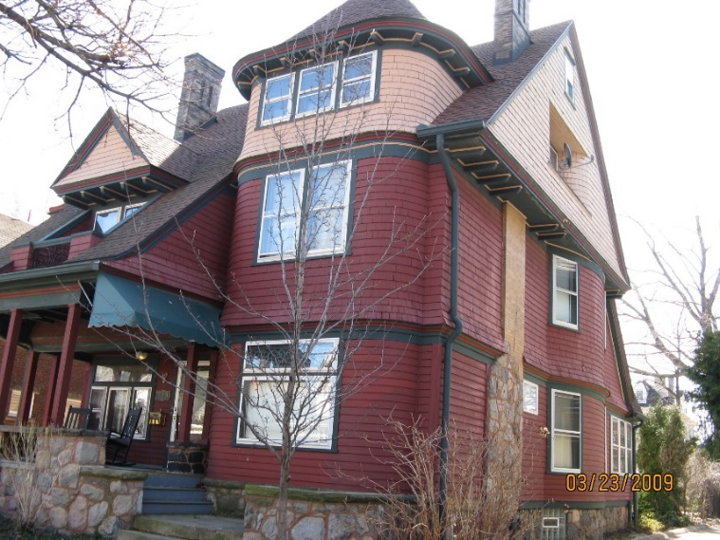
?
519 West 9th Street, City of Erie

Slide 8
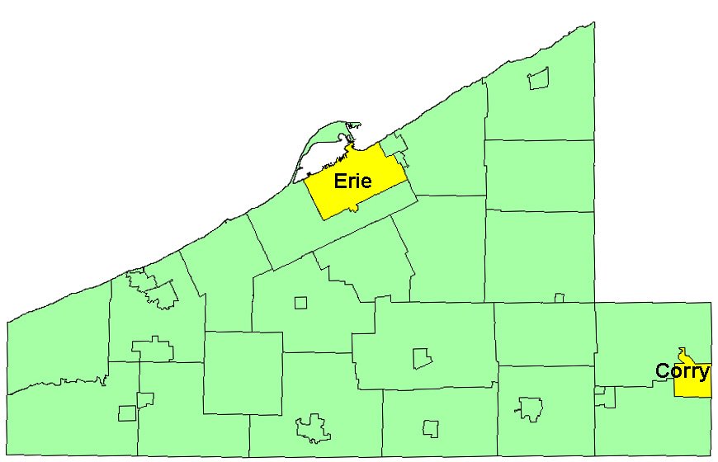
2 Phase Survey Project
Erie & Corry, early 2014
County late 2014

Slide 9
Erie Co. Municipalities
Cities: Corry, Erie
Boroughs:
Albion, Cranesville, Edinboro, Elgin, Girard, Lake City, McKean, Mill Village, North East, Platea, Union City, Waterford, Wattsburg, Wesleyville
Townships:
Amity, Concord, Conneaut, Elk Creek, Fairview, Franklin, Girard, Greene, Green, Greenfield, Harborcreek, Lawrence Park, LeBoeuf, McKean, Millcreek, Springfield, Summit, Union, Venango, Washington, Waterford, Wayne

Slide 11
Results!
31,470 properties identified, evaluated, mapped, classified, documented.
543 properties on or determined eligible for National Register
397 properties potentially eligible
Website www.eriebuildings.info
Evaluated 25 historic districts
16 on / eligible for National Register

Slide 12
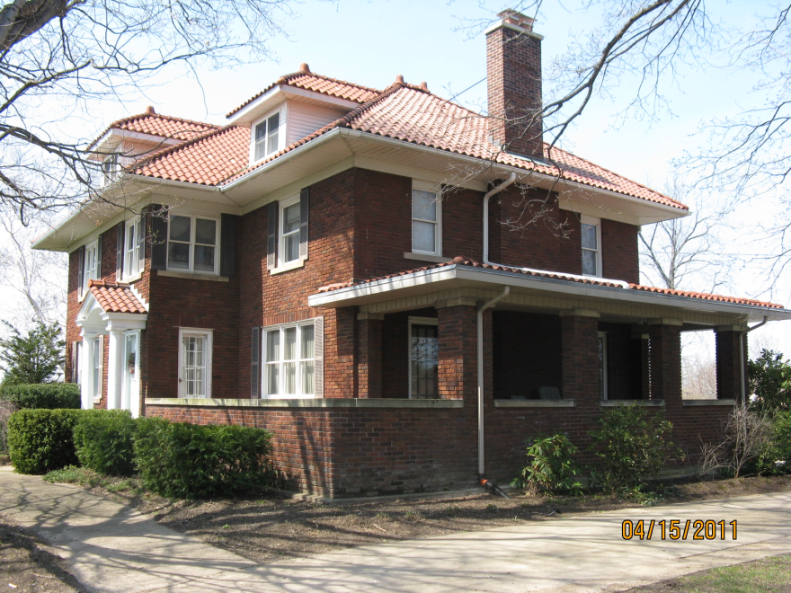
More Results!
GIS maps of 38 municipalities
3,500 properties documented on state database
Classified all resources by architectural significance
Harborcreek

Slide 13
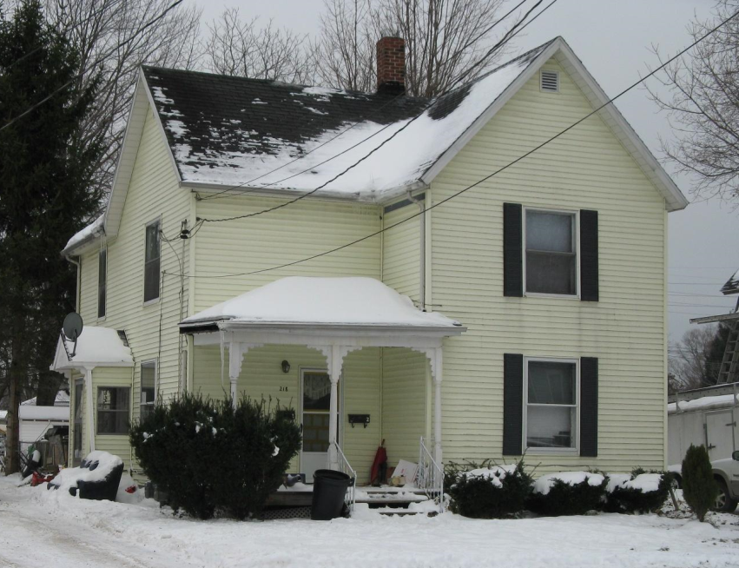
Recommendations
Enlarge survey to include resources constructed from 1940 (WWII & post-war resources not surveyed)
Establish 3 historic districts: West 10th Street, Glenwood, Academy
“Populate” website.
Girard

Slide 14
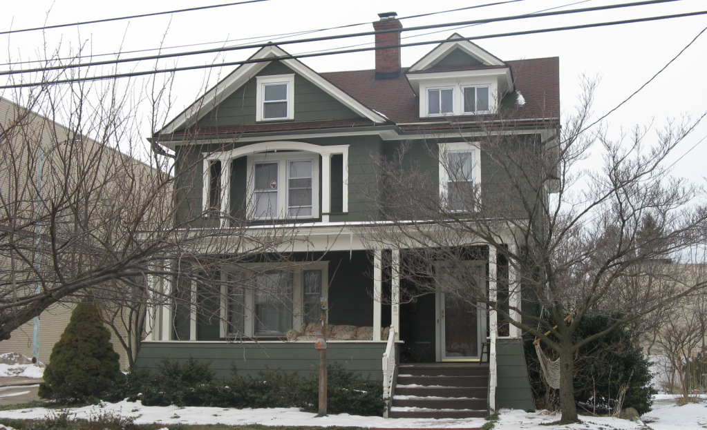
And more Recommendations
Encourage participation of historic information gathering
Use resource classification & mapping for preservation planning & resource protection.
North East

Slide 16
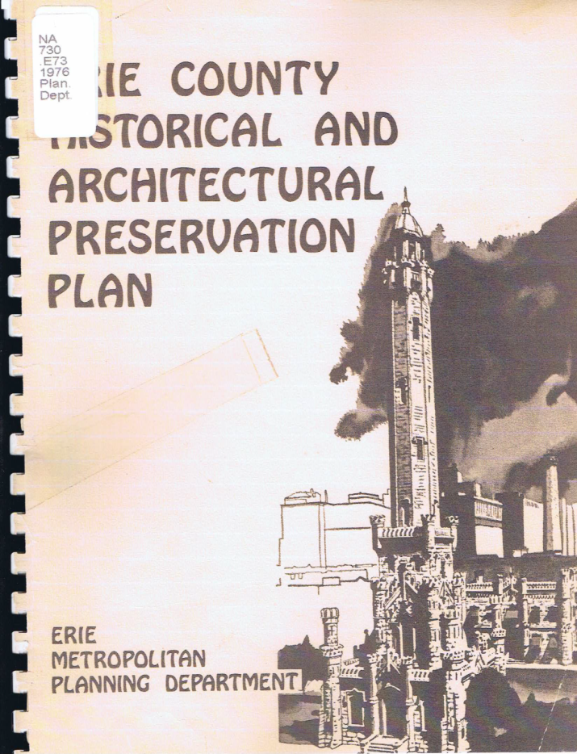
Background Information
Erie Co. Historical Society
1976 Survey
1982, 1983 Survey
Other
Local Historical Societies
Co. Planning information
PHMC Files

Slide 17
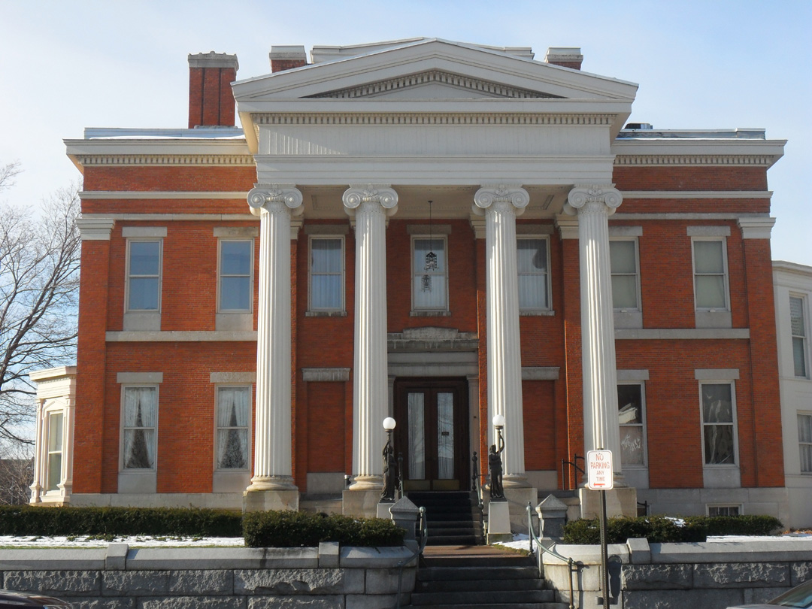
Photography / Field Survey
Mercyhurst students photographed approx. 500 resources
Wise - additional 300 resources
Reed Mansion

Slide 18
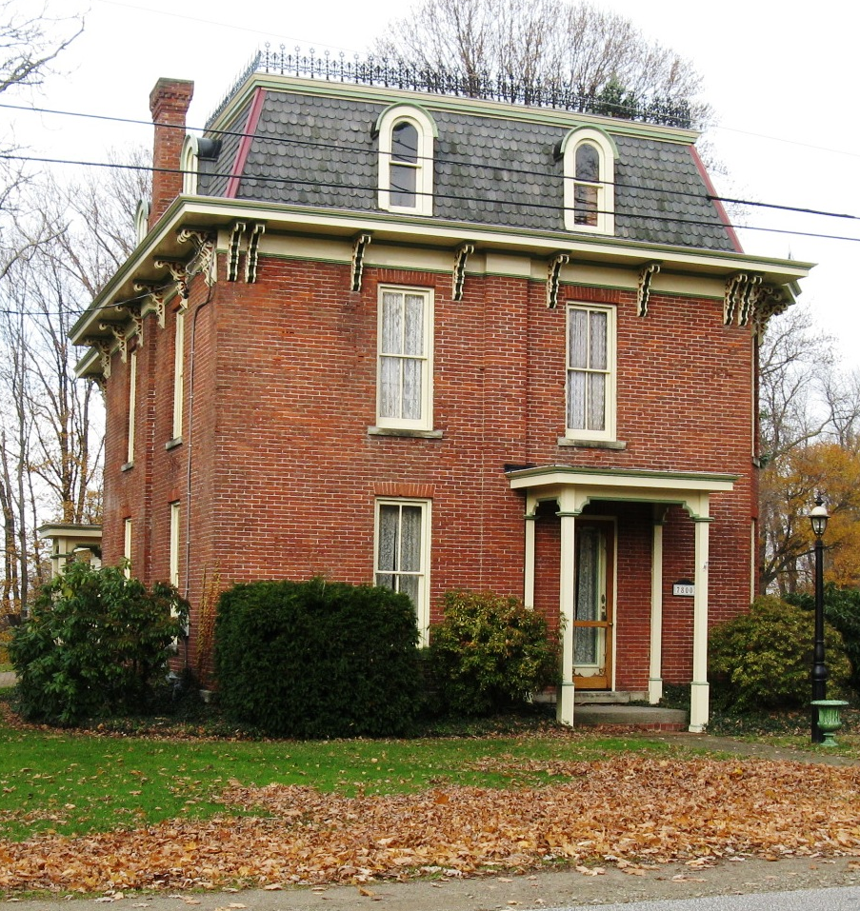
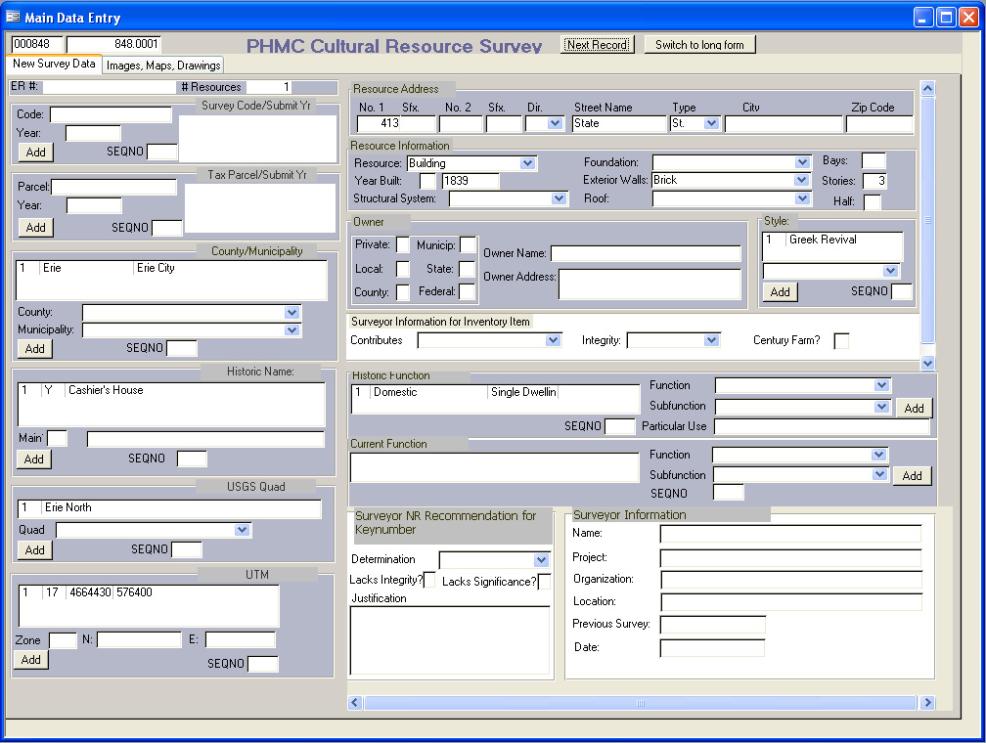
PHMC Access Database
Information updated
Approximately 3,500 most significant resources
Fairview

Slide 19
GIS* Classification& Mapping
Existing Co. GIS Data
Existing Co. Tax Assessment
31,370 properties pre-1940
*Geographical Information System

Slide 20
Photograph Assessment
Co. Assessor’s Website
Photos dated 2008 to 2014

Slide 21
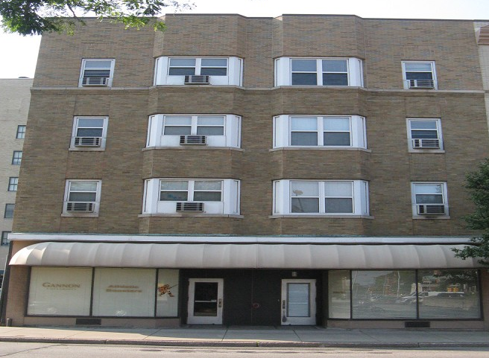
Architectural Classification
Significance
Exterior
No historic research
Integrity
5 Levels (Class 1-5)
National Register Criteria

Slide 22
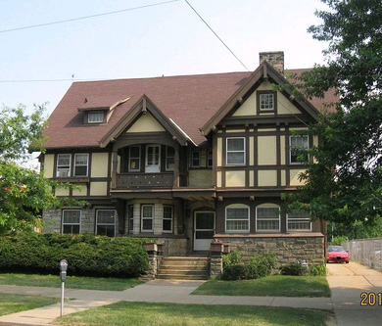
Class 1
Most Significant Resources
Listed on National Register
Determined eligible for NR
543 Properties
221 West 6th St.

Slide 23
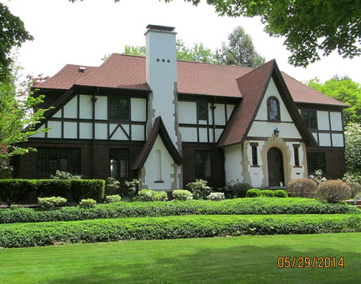
Class 2
Significant Resources
Potentially eligible for the National Register
Architecturally significant
397 Properties
1605 South Shore Drive

Slide 24
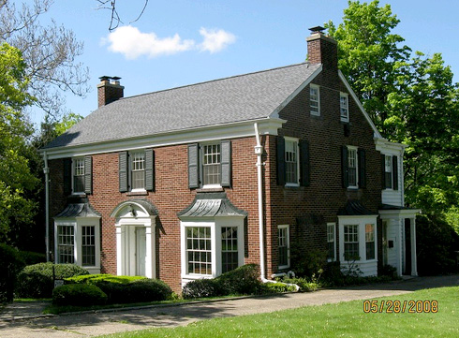
Class 3
Locally Significant Buildings
May not meet NR criteria
Fine Example
Contributes to potential HD
Intact
2,557 Properties
4226 Sassafras St.

Slide 25
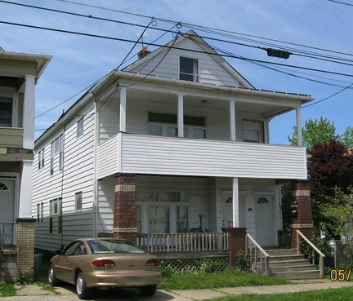
Class 4
Not Architecturally Significant
Do not individually meet National Register Criteria
Integrity issues
Vernacular
Could contribute to Historic District
15,636 Properties
258 East 29th St.

Slide 26
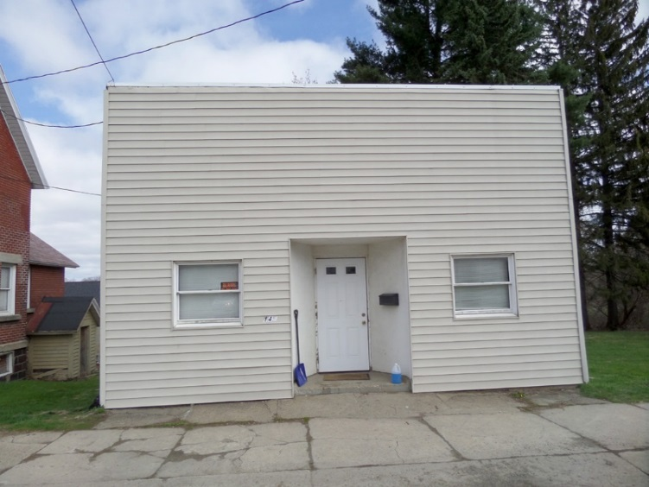
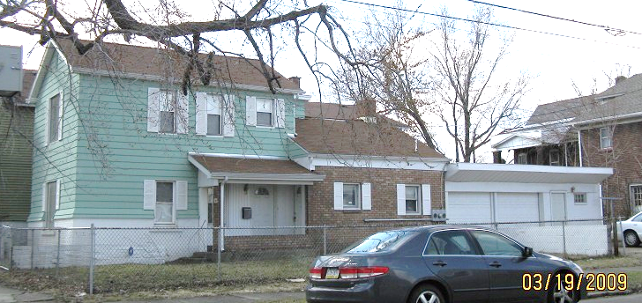
Class 5
Least Architecturally Significant
Highly altered
12,338 Properties

Slide 27
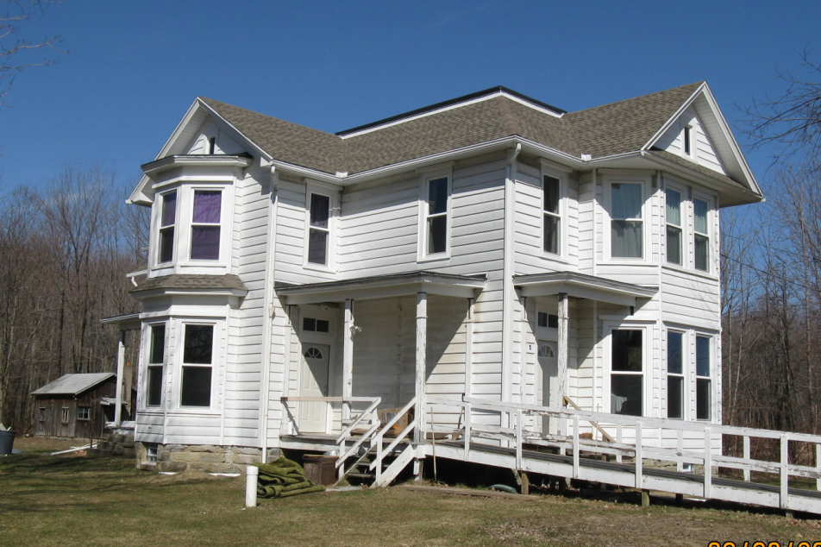
Lawrence Park Conneaut Twp.

Slide 28
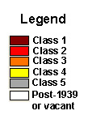
Classifications Mapped!

Slide 30
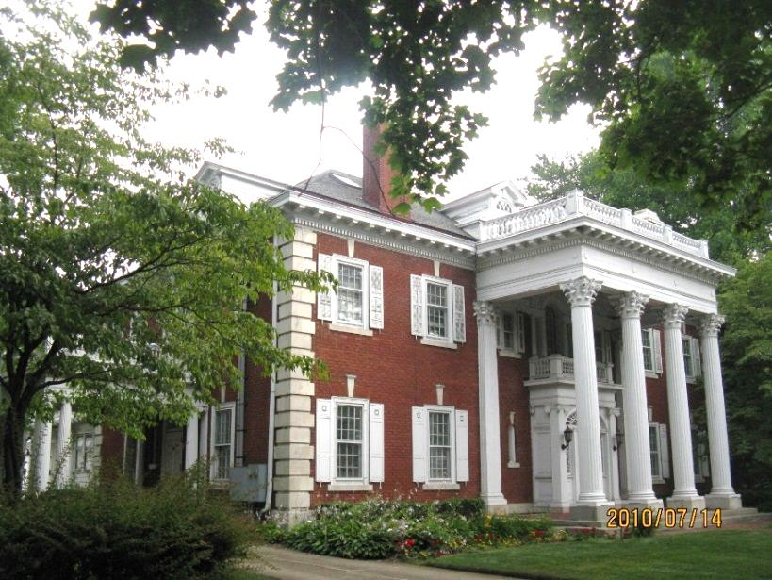
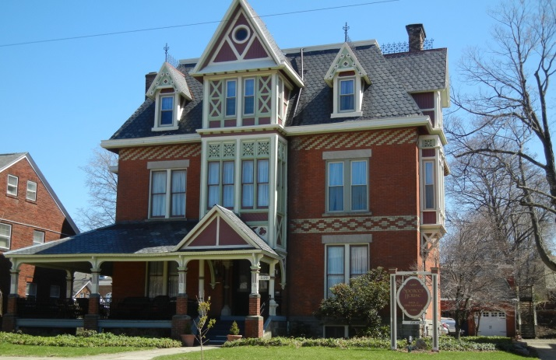
West Sixth Street HD
558 West 6th Street

Slide 31
West Sixth Street HD

Slide 32
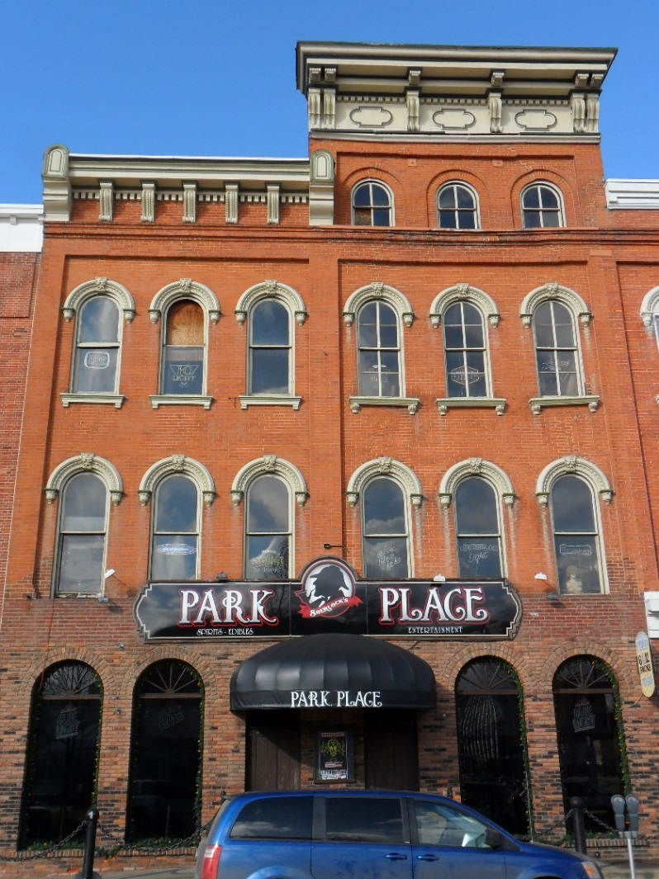
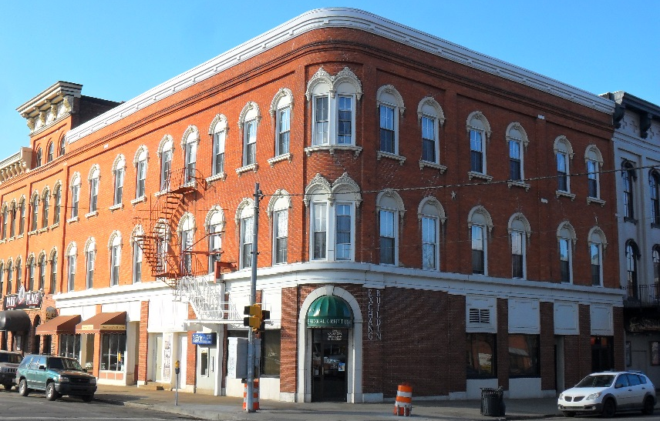
West Park Place HD

Slide 33
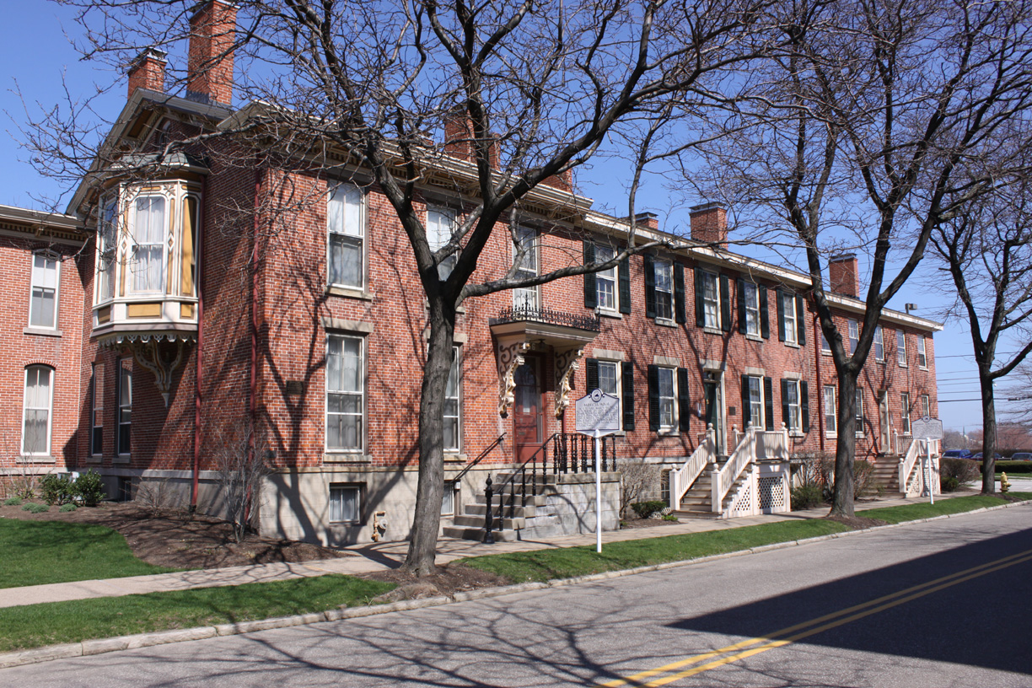
Federal Row HD
Existing HD boundary
Recommendation: maintain existing boundary

Slide 34
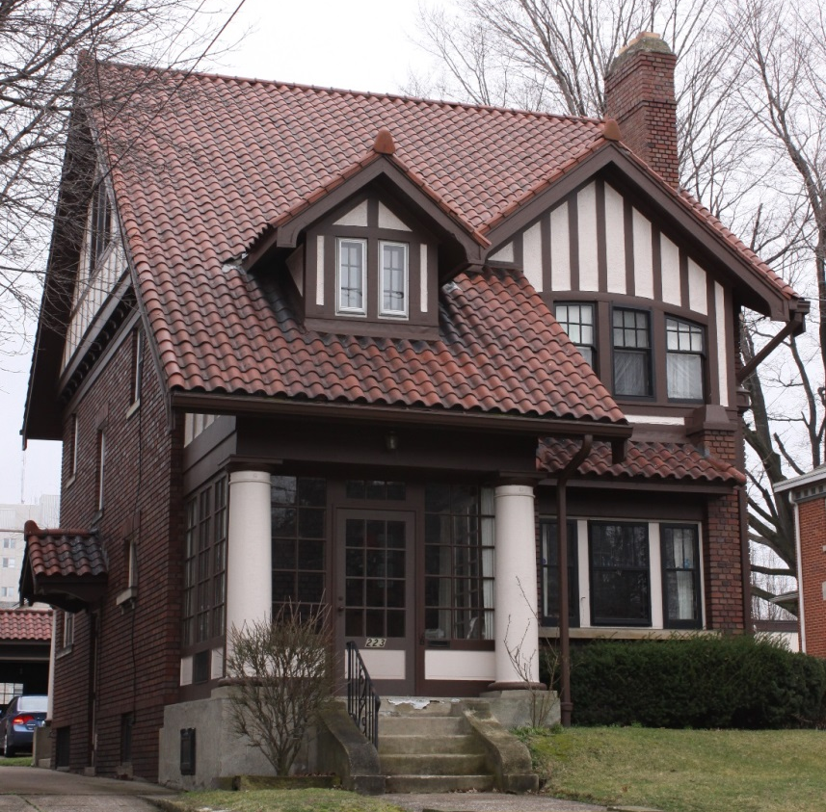
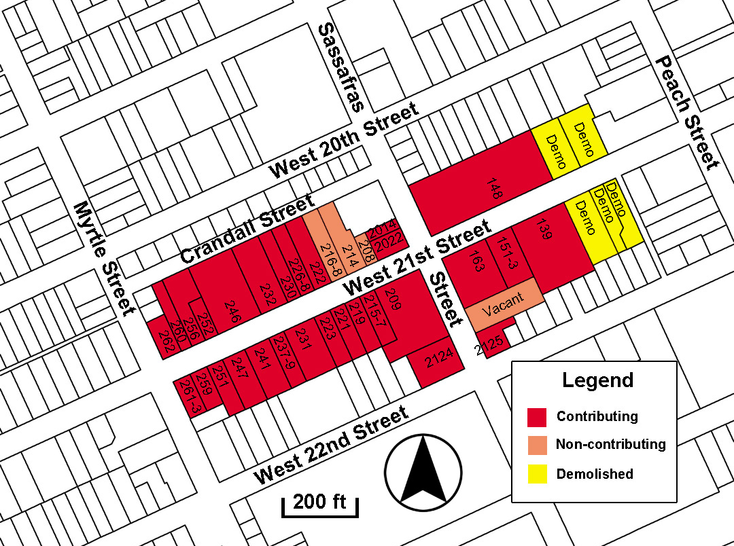
West 21st Street HD
Recommendation: maintain existing boundary

Slide 35
E. 12th Street HD

Slide 36
West 10th Street

Slide 37
Adamstown HD

Slide 38
Adamstown HD (DOE 1995)
Pursue NR Listing

Slide 39
Lakeside HD (DOE 1995)
1942 Lza
1942 Lakeside Dr.

Slide 40
Lakeside HD
“Local” Historic District Option

Slide 41
Glenwood Hills
DOE 2000
Recommendation: Pursue NR nomination

Slide 42
Dobbins & Dunlap Subdivision
Not Evaulated
Not thought eligible
No Action

Slide 43
Academy HD
Potential HD unevaluated
Pursue DOE

Slide 44
Glenwood HD (proposed)

Slide 45
Glenwood HD
Potential District
Pursue DOE

Slide 46
Frontier Place

Slide 47
12th St. Industrial Corridor HD
Potential HD
PHMC Review

Slide 48
Frontier Place
District determined not eligible
Pursue DOE within 20 years.

Slide 49
Corry HD

Slide 50
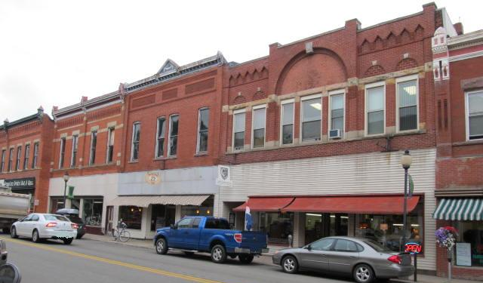
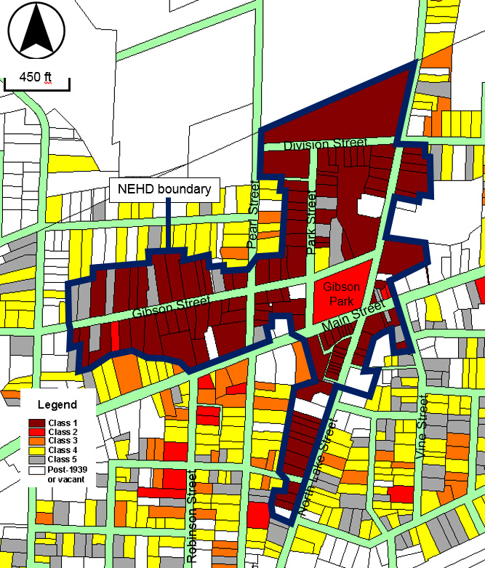
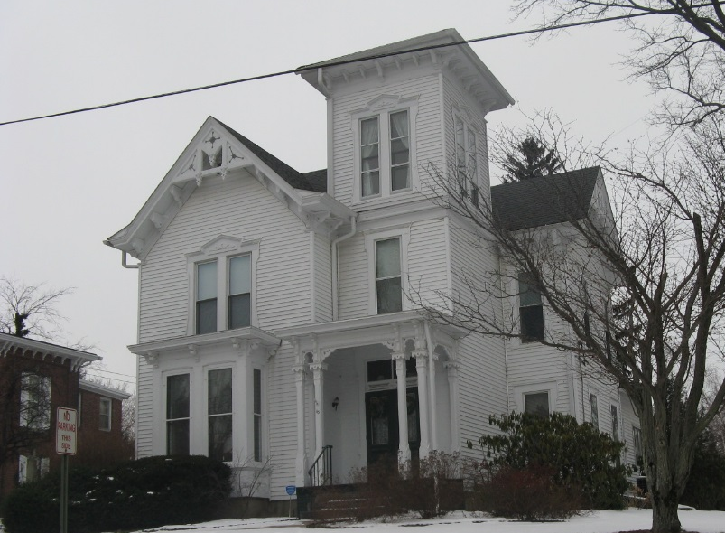
North East HD
Recommendation: maintain existing boundary

Slide 51
Union City HD
Consider Boundary Expansion

Slide 52
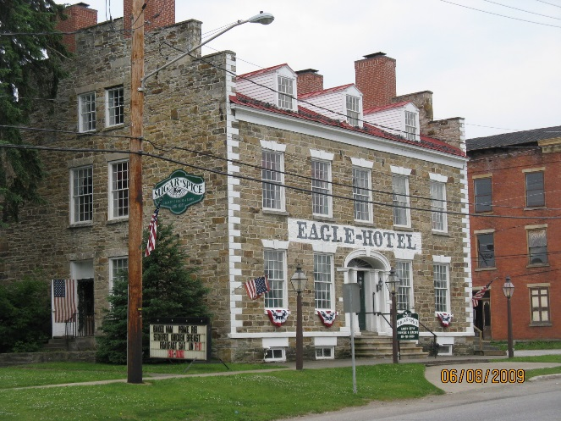
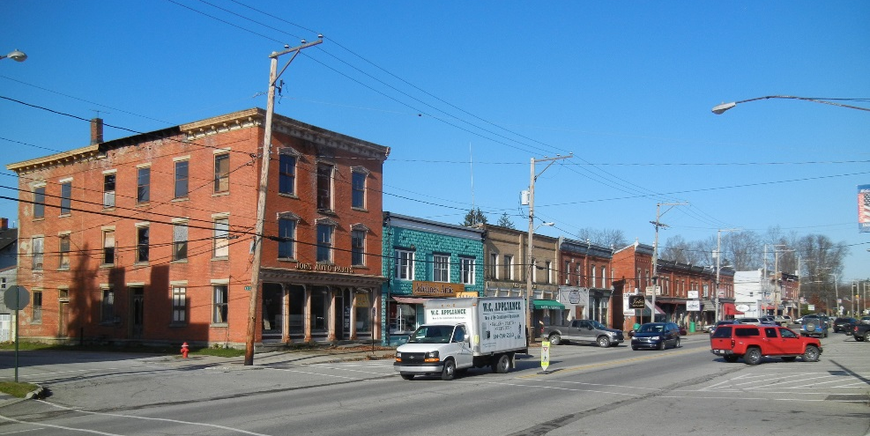
Waterford Borough HD
Recommendation: maintain existing boundary

Slide 53
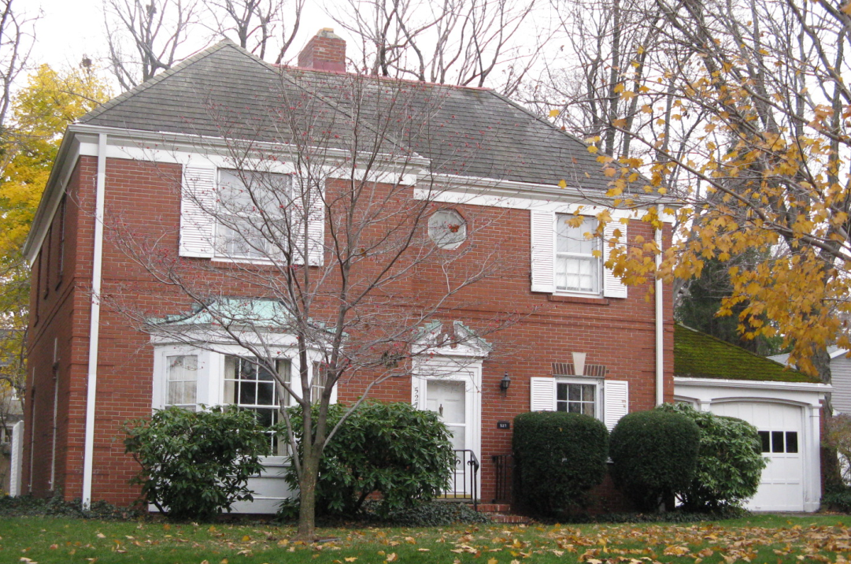
Lawrence Park HD (DOE)
Continue to pursue NR Nomination

Slide 54
Pumphouse Park HD (DOE)
DOE 2000
No Action necessary

Slide 55
Lakewood, Millcreek Twp.
Not Eligible
No Recommended Action

Slide 56
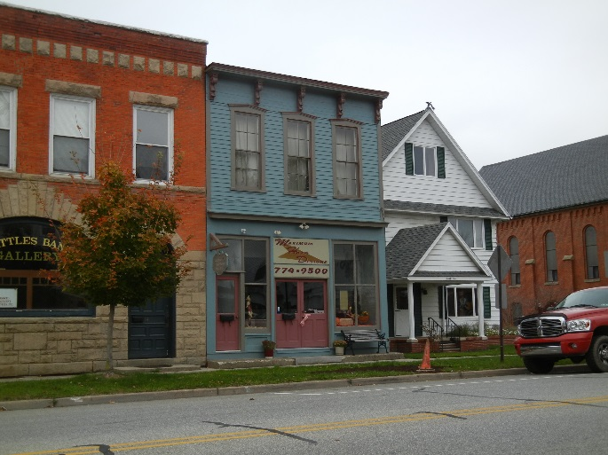
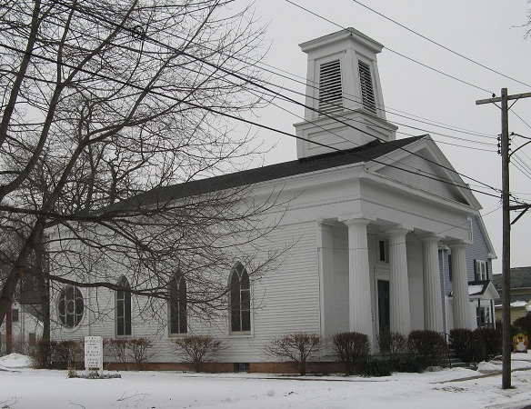
Girard Borough HD
Eligible for National Register 1987
Potential for expansion

Slide 57
Historic Districts
Determined Eligible for National Register
Adamstown Subdivision (1995)
Lakeside Subdivision (1995)
East 12th Street (1995)
Glenwood Hills (2000)
Lower State Street (2006)

Slide 58
Historic Districts
Ineligible or Unevaluated Districts
Navy Farm Subdivision HD
Glenwood Park HD
Upper State Street HD
East 6th Street HD
Potential Local Historic Districts
Academy HD
Frontier Place HD

Slide 59
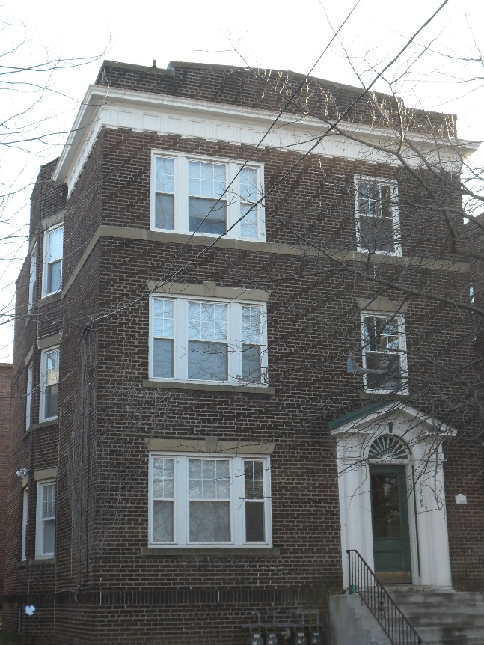
Recommended HDs
National Register District
West 10th Street
Glenwood Hills
HD Considerations
West 12th Street (industrial)
Frontier Place (denied)
Academy (unevaluated)
West of Academy (poss.)

Slide 60
www.eriebuildings.info

Slide 61
www.eriebuildings.info

Slide 62
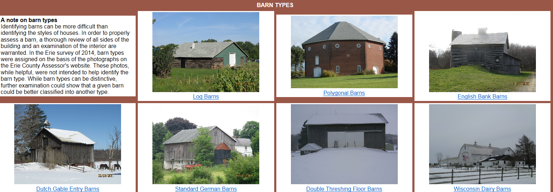

Slide 63
Thank You

